Slide 1
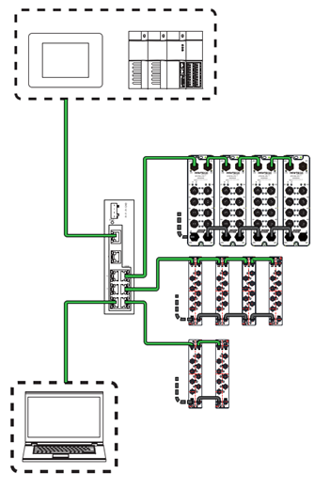
IO-Link Masters and Hubs
What and why do I need IO-Link?
Make sensors and actuators “smarter” using a communication protocol providing configuration options and diagnostics data directly from the PLC
Support, troubleshoot, and maintain the machine remotely from the physical level
Fieldbus real-time communication protocol, reduce the amount of PLC I/O modules
Easy wiring, reduce the size of control cabinets and wiring complexity
Supported by most of the sensor/actuator vendors

